Slide 1
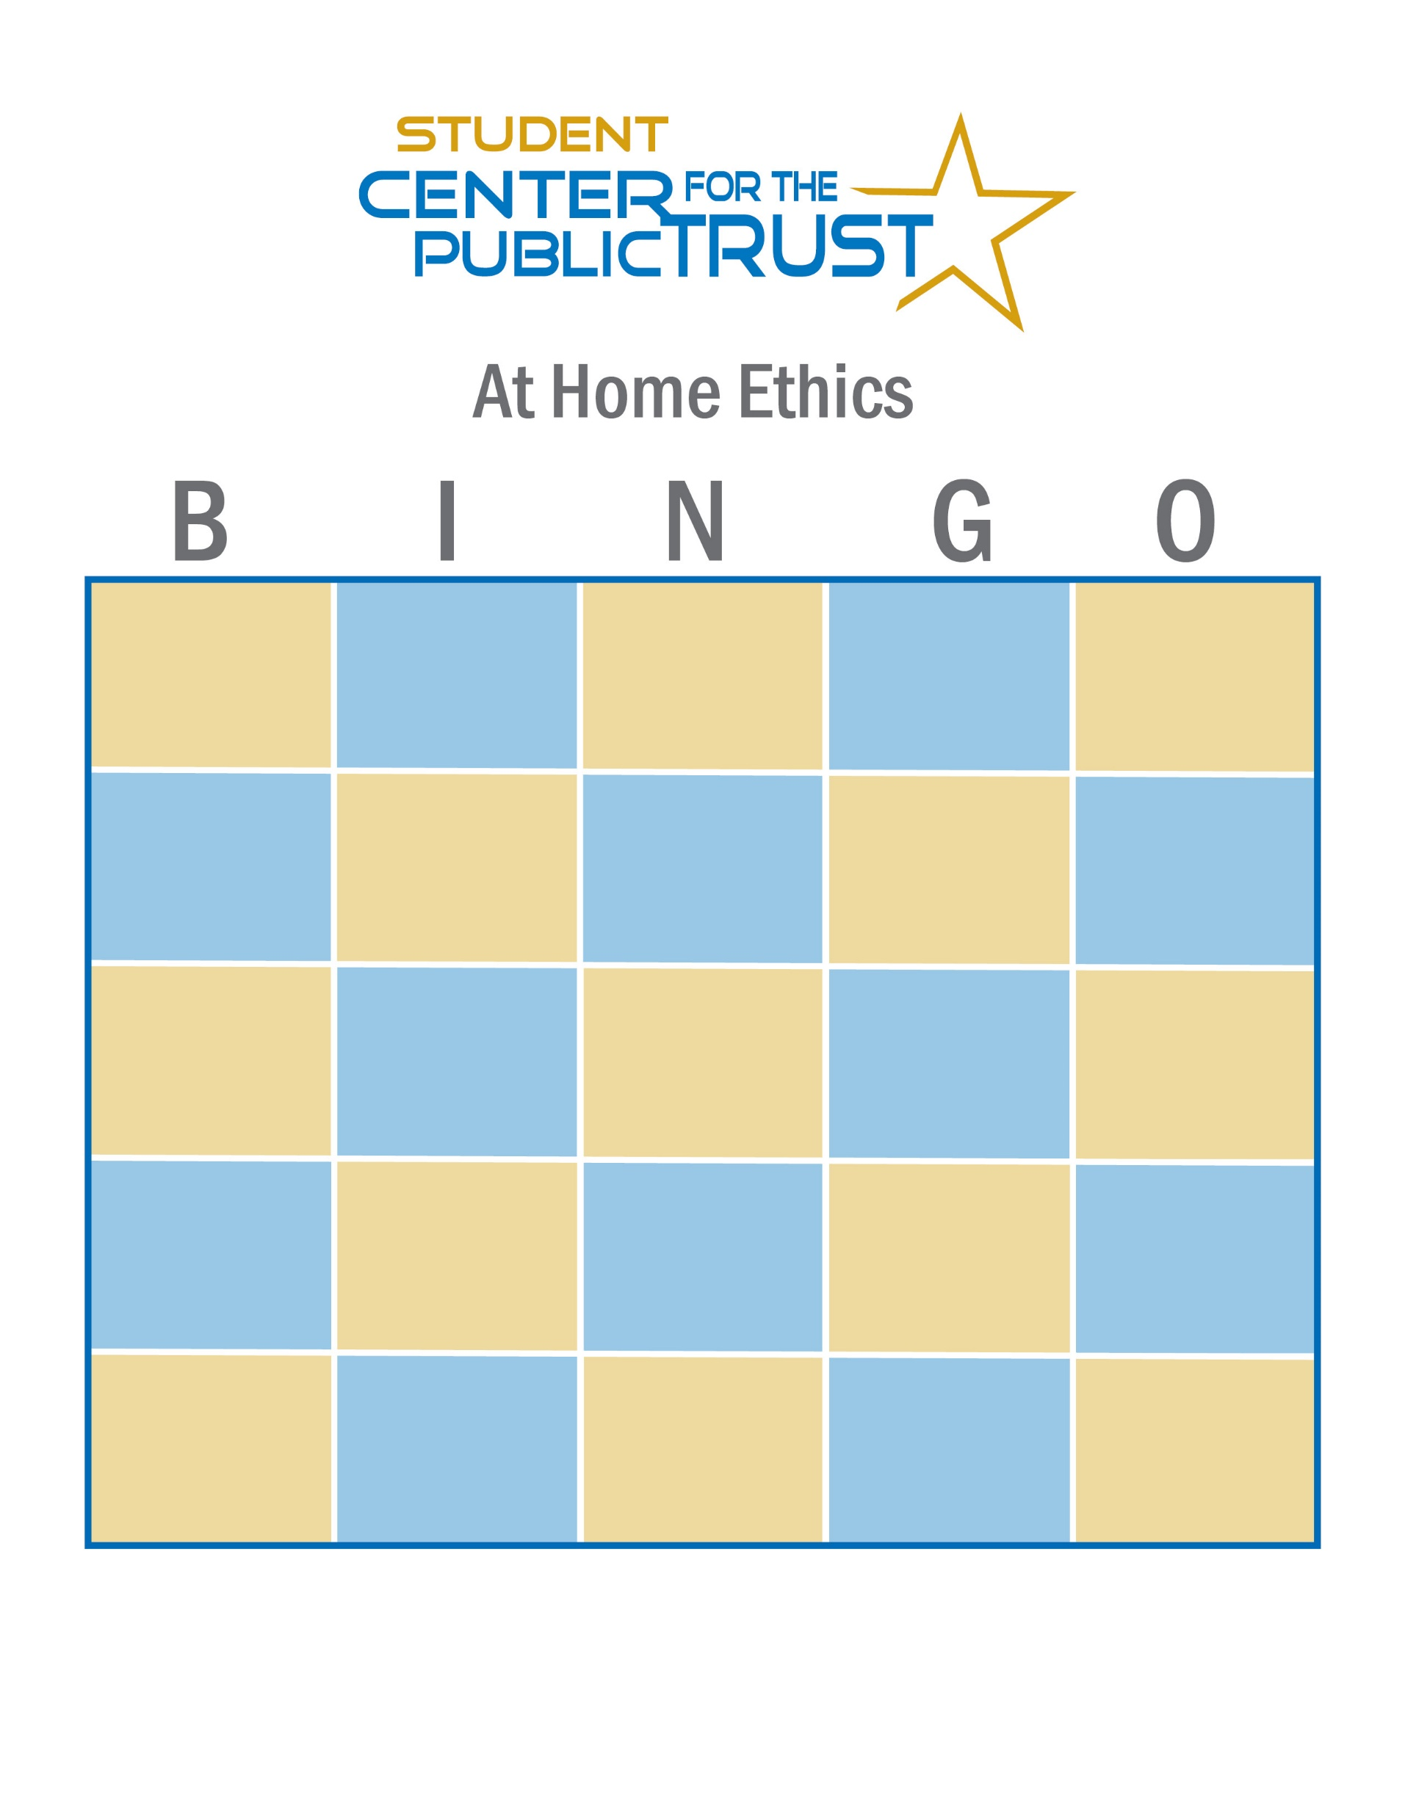
Company Culture
Ethical Decision Making
Code of Ethics
Mentor
Virtue
Mark if you have non expired milk in the fridge
Discrimination
Organizational Leadership
Conflict
Management
Fraud
Transparency
Conflicts of
Interest
School
Logo
Whistleblower
Diversity
Training
Mark if you can name 3 Taylor Swift Songs
Accountability
Follower
Leader
Integrity
Mark if you can sing your school’s fight song
Mark if you have seen at least 1 Harry Potter movie
Quality
Feedback
Empowering
Employees
Character

